Slide 1







Deep Learning with Keras with TensorFlow

Slide 2
Convolutional Neural Net (CNN)

Slide 3

By the end of this lesson, you will be able to:
Implement CNN architecture
Implement Deep CNN
Optimize CNNs using pooling layers

Slide 4
Success and History

Slide 5
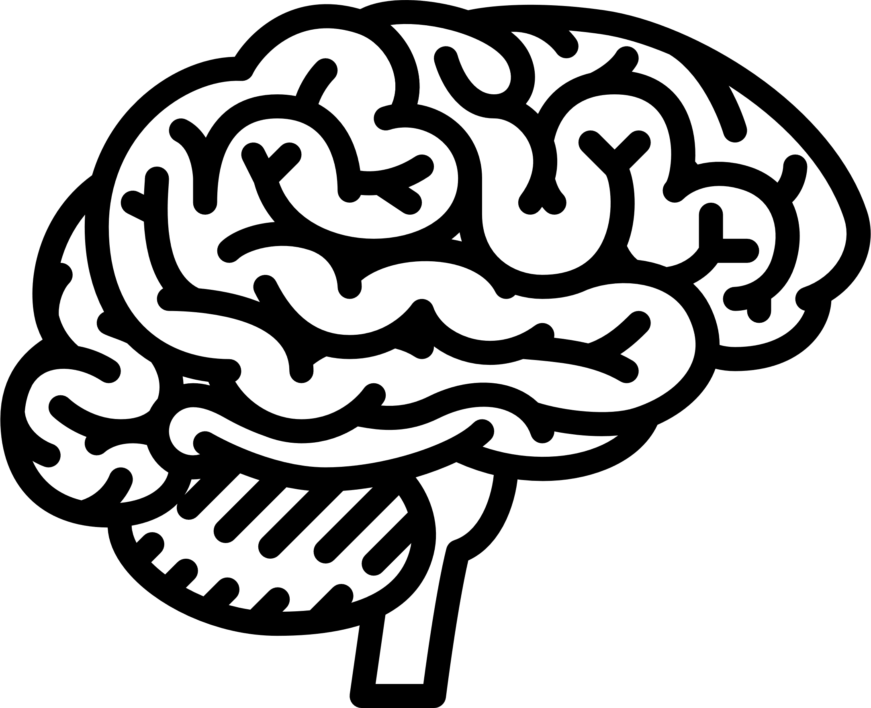
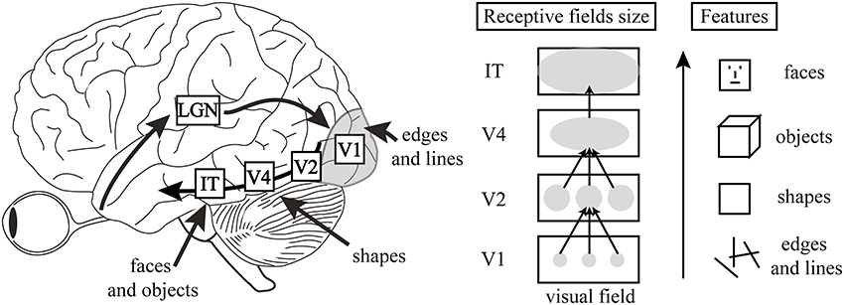
Human Visual and CNN
LGN
V1
IT
V4
V2
Edges
And lines
Faces
And objects
Shapes
The idea of CNNs was neurobiologically motivated by the findings of locally-sensitive and orientation-selective nerve cells in the visual cortex.
Inventors of CNN designed a network structure that implicitly extracts relevant features.
Convolutional Neural Networks are a special kind of multilayer neural networks.

Slide 6
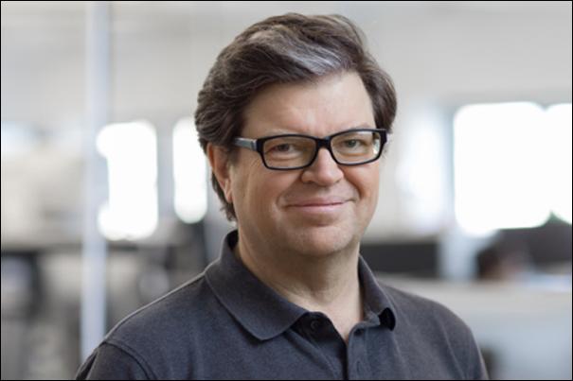
History of CNN
Success
Stories
In 1995, Yann LeCun, professor of computer science at the New York University, introduced the concept of convolutional neural networks.

Slide 7
The Core Idea Behind CNN
Local Connections
Layering
Spatial Invariance
Represent how each set of neurons in a cluster is connected to each other, which in turn represents a set of features

Slide 8
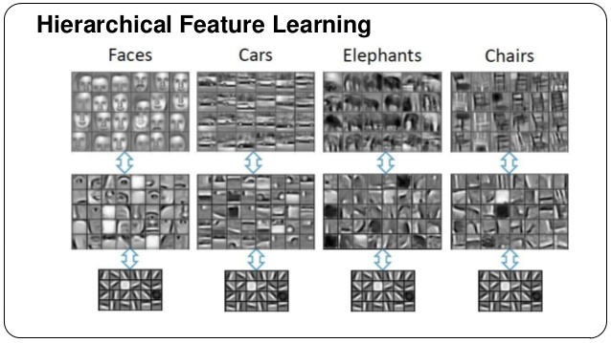
The Core Idea Behind CNN
Local Connections
Layering
Spatial Invariance
Represents the hierarchy in features that are learned

Slide 9
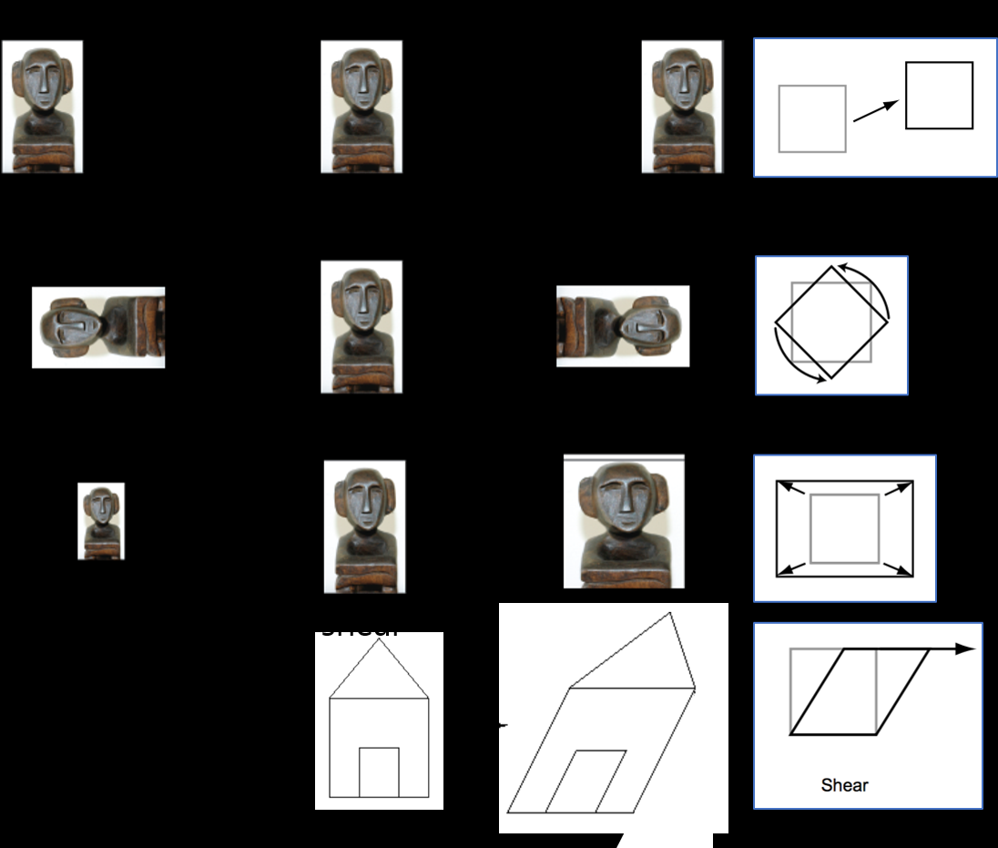
The Core Idea Behind CNN
Local Connections
Layering
Spatial Invariance
Represents the capability of CNNs to learn abstractions invariant of size, contrast, rotation, and variation

Slide 10
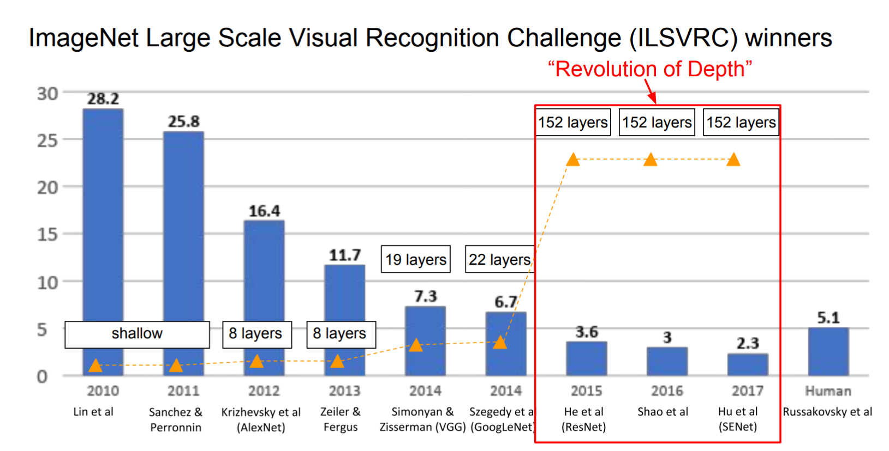
Few Popular CNNs
LeNet, 1998
AlexNet, 2012
VGGNet, 2014
ResNet, 2015

Slide 11
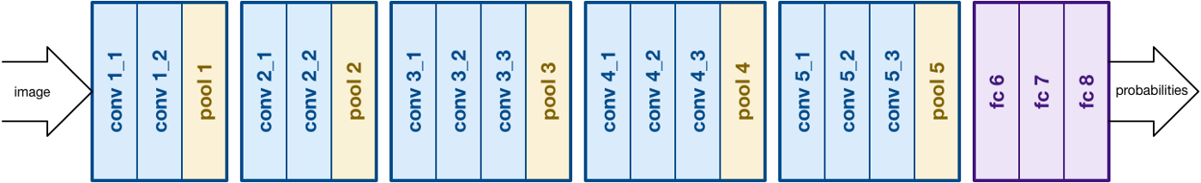
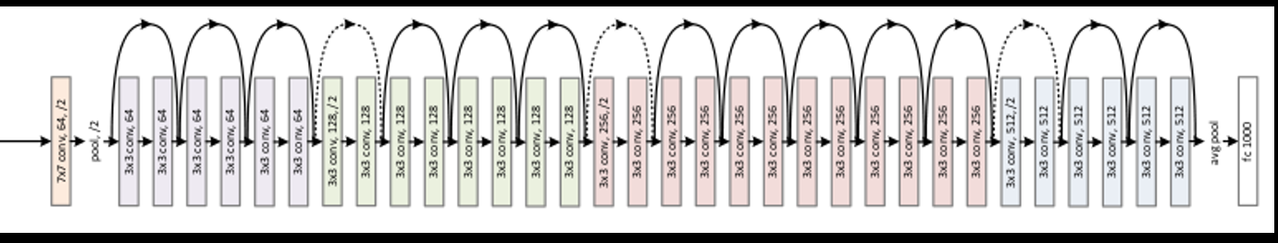
CNN Architectures
VGGNet
16 layers
Only 3*3 convolutions
138 million parameters
ResNet
152 layers
ResNet50

Slide 12
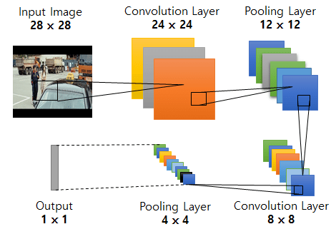
CNN Applications
Input A
Task A
Layer n
AnB : Frozen Weights
Back-Propagation
Input B
Task B
Back-Propagation
Transfer Learning and Fine Tuning
Feature Extraction

Slide 13
Working of CNNs

Slide 14


Learning an Image
CNN focuses on smaller and specific patterns than the whole image.
Output
“beak” detector
It’s convenient and effective to represent a smaller region with fewer parameters, thereby reducing computational complexity.

Slide 15
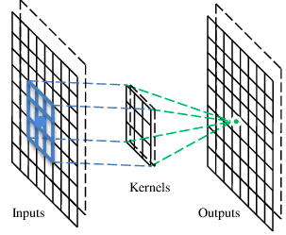
The Convolutional Layer
A CNN is a neural network with convolutional layers (and other layers). A convolutional layer has several filters that perform the convolution operation.
Beak Detector
Filter

Slide 16

The Convolution Operation
Consider a 6x6 image convolved with 3x3 filter(s) to give an output of size 4x4.
1 | 0 | 0 | 0 | 0 | 1
0 | 1 | 0 | 0 | 1 | 0
0 | 0 | 1 | 1 | 0 | 0
1 | 0 | 0 | 0 | 1 | 0
0 | 1 | 0 | 0 | 1 | 0
0 | 0 | 1 | 0 | 1 | 0
1 | -1 | -1
-1 | 1 | -1
-1 | -1 | 1
Filter 1
*
-1 | 1 | -1
-1 | 1 | -1
-1 | 1 | -1
Filter 2
6 x 6 image
……
Each filter detects a small pattern (3 x 3)
Note: Filters can be considered network parameters to be learned.

Slide 17
The Convolution Operation
Shift the filter around the input matrix (commonly known as stride) once a convolved output is achieved.
Stride=1
1 | 0 | 0 | 0 | 0 | 1
0 | 1 | 0 | 0 | 1 | 0
0 | 0 | 1 | 1 | 0 | 0
1 | 0 | 0 | 0 | 1 | 0
0 | 1 | 0 | 0 | 1 | 0
0 | 0 | 1 | 0 | 1 | 0
1 | -1 | -1
-1 | 1 | -1
-1 | -1 | 1
Dot product
Filter 1
3
-1
6 x 6 image

Slide 18
The Convolution Operation
Stride=2
1 | 0 | 0 | 0 | 0 | 1
0 | 1 | 0 | 0 | 1 | 0
0 | 0 | 1 | 1 | 0 | 0
1 | 0 | 0 | 0 | 1 | 0
0 | 1 | 0 | 0 | 1 | 0
0 | 0 | 1 | 0 | 1 | 0
1 | -1 | -1
-1 | 1 | -1
-1 | -1 | 1
Dot product
Filter 1
3
-3
6 x 6 image
Note: If you change the stride size, the convolved output will vary (only outputting intense pixels).

Slide 19
The Convolution Operation
Stride=1
1 | 0 | 0 | 0 | 0 | 1
0 | 1 | 0 | 0 | 1 | 0
0 | 0 | 1 | 1 | 0 | 0
1 | 0 | 0 | 0 | 1 | 0
0 | 1 | 0 | 0 | 1 | 0
0 | 0 | 1 | 0 | 1 | 0
1 | -1 | -1
-1 | 1 | -1
-1 | -1 | 1
Dot product
Filter 1
3
-1
-3
-1
-3
1
0
-3
6 x 6 image
-3
-3
0
1
3
-2
-2
-1
4 x 4 image

Slide 20
The Convolution Operation
The convolution operation gets repeated for each filter resulting in a feature map.
Stride=1
1 | 0 | 0 | 0 | 0 | 1
0 | 1 | 0 | 0 | 1 | 0
0 | 0 | 1 | 1 | 0 | 0
1 | 0 | 0 | 0 | 1 | 0
0 | 1 | 0 | 0 | 1 | 0
0 | 0 | 1 | 0 | 1 | 0
-1 | 1 | -1
-1 | 1 | -1
-1 | 1 | -1
Dot product
Filter 2
3
-1
-3
-1
-1
-1
-1
-1
-3
1
0
-3
-1
-1
-2
1
6 x 6 image
Feature
Map
-3
-3
0
1
-1
-1
-2
1
3
-2
-2
-1
-1
0
-4
3
Two 4 x 4 images
Forming 2 x 4 x 4 matrix

Slide 21
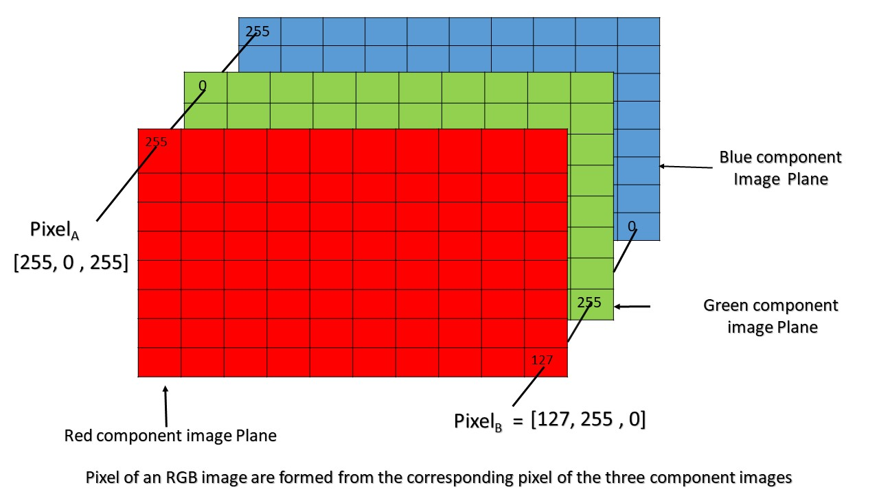
RGB Images
When RGB image is used as input to CNN, the depth of filter is always equal to the depth
of image (3 in case of RGB).
1 | -1 | -1
-1 | 1 | -1
-1 | -1 | 1
-1 | 1 | -1
-1 | 1 | -1
-1 | 1 | -1
1 | -1 | -1
-1 | 1 | -1
-1 | -1 | 1
-1 | 1 | -1
-1 | 1 | -1
-1 | 1 | -1
1 | -1 | -1
-1 | 1 | -1
-1 | -1 | 1
-1 | 1 | -1
-1 | 1 | -1
-1 | 1 | -1
3-dimensional filter 1
3-dimensional filter 2
1 | 0 | 0 | 0 | 0 | 1
0 | 1 | 0 | 0 | 1 | 0
0 | 0 | 1 | 1 | 0 | 0
1 | 0 | 0 | 0 | 1 | 0
0 | 1 | 0 | 0 | 1 | 0
0 | 0 | 1 | 0 | 1 | 0
1 | 0 | 0 | 0 | 0 | 1
0 | 1 | 0 | 0 | 1 | 0
0 | 0 | 1 | 1 | 0 | 0
1 | 0 | 0 | 0 | 1 | 0
0 | 1 | 0 | 0 | 1 | 0
0 | 0 | 1 | 0 | 1 | 0
1 | 0 | 0 | 0 | 0 | 1
0 | 1 | 0 | 0 | 1 | 0
0 | 0 | 1 | 1 | 0 | 0
1 | 0 | 0 | 0 | 1 | 0
0 | 1 | 0 | 0 | 1 | 0
0 | 0 | 1 | 0 | 1 | 0

Slide 22
CNN
Problem Scenario: Consider the MNIST dataset from the previous lesson wherein, you were hired by one of the major AI giants planning to build the best image classifier model available till date. Also, to do so, you used a multilayered neural network. However, Keras being the most commonly used libraries for deep learning, you would have to use Keras this time.
Objective:
Build a Keras-based image classification model on the MNIST dataset.
Access: Click the Practice Labs tab on the left panel. Now, click on the START LAB button and wait while the lab prepares itself. Then, click on the LAUNCH LAB button. A full-fledged jupyter lab opens, which you can use for your hands-on practice and projects.

Slide 23
Pooling

Slide 24


Pooling Layer
The pooling layer gradually reduces the spatial size of each matrix within the feature map such that the amount of parameters and computation is reduced in the network.
Subsampling
Note: The most commonly used pooling approach is max pooling.

Slide 25
Pooling Layer
Stride=1
1 | 0 | 0 | 0 | 0 | 1
0 | 1 | 0 | 0 | 1 | 0
0 | 0 | 1 | 1 | 0 | 0
1 | 0 | 0 | 0 | 1 | 0
0 | 1 | 0 | 0 | 1 | 0
0 | 0 | 1 | 0 | 1 | 0
1 | -1 | -1
-1 | 1 | -1
-1 | -1 | 1
Dot product
Filter 1
3
-1
-3
-1
-3
1
0
-3
Max pool (filter 2x2, stride =2)
3 | 0
3 | 1
6 x 6 image
-3
-3
0
1
3
-2
-2
-1
4 x 4 image
Note: The most commonly used pooling approach is max pooling.

Slide 26
The CNN Architecture
The CNN architecture comprises multiple combinations of convolution and pooling layers.
Convolution
Max Pooling
Resultant image is smaller than the original image
Convolution
Max Pooling

Slide 27
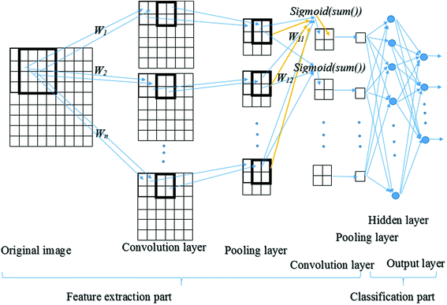
The CNN Architecture
The reduced image from these layers (convolution + pooling) is then passed through the activation function.

Slide 28
Convolution vs. Fully-Connected Networks

Slide 29
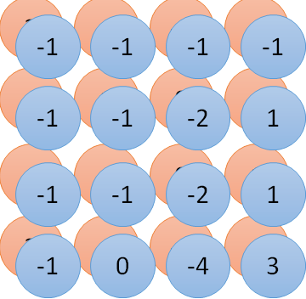
Convolution vs. Fully-Connected Networks
1 | 0 | 0 | 0 | 0 | 1
0 | 1 | 0 | 0 | 1 | 0
0 | 0 | 1 | 1 | 0 | 0
1 | 0 | 0 | 0 | 1 | 0
0 | 1 | 0 | 0 | 1 | 0
0 | 0 | 1 | 0 | 1 | 0
1 | -1 | -1
-1 | 1 | -1
-1 | -1 | 1
-1 | 1 | -1
-1 | 1 | -1
-1 | 1 | -1
1 | 0 | 0 | 0 | 0 | 1
0 | 1 | 0 | 0 | 1 | 0
0 | 0 | 1 | 1 | 0 | 0
1 | 0 | 0 | 0 | 1 | 0
0 | 1 | 0 | 0 | 1 | 0
0 | 0 | 1 | 0 | 1 | 0
……
……
Image
Convolution
Fully-connected Network

Slide 30
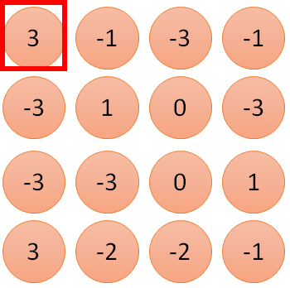
Fewer Parameters
The CNN below is only connected to 9 inputs (not fully connected).
1 | -1 | -1
-1 | 1 | -1
-1 | -1 | 1
1
1
Filter 1
2
0
3
0
3
4:
0
1 | 0 | 0 | 0 | 0 | 1
0 | 1 | 0 | 0 | 1 | 0
0 | 0 | 1 | 1 | 0 | 0
1 | 0 | 0 | 0 | 1 | 0
0 | 1 | 0 | 0 | 1 | 0
0 | 0 | 1 | 0 | 1 | 0
…
0
8
1
9
0
10:
0
…
13
0
6 x 6 image
14
0
15
1
16
1
…

Slide 31
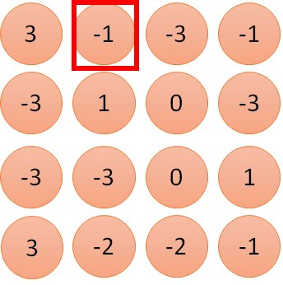
Fewer Parameters
The number of parameters are reduced even further after the first stride.
1 | -1 | -1
-1 | 1 | -1
-1 | -1 | 1
1
1
Filter 1
2
0
3
0
3
4:
0
1 | 0 | 0 | 0 | 0 | 1
0 | 1 | 0 | 0 | 1 | 0
0 | 0 | 1 | 1 | 0 | 0
1 | 0 | 0 | 0 | 1 | 0
0 | 1 | 0 | 0 | 1 | 0
0 | 0 | 1 | 0 | 1 | 0
…
0
8
1
9
0
-1
10:
0
…
13
0
6 x 6 image
14
0
15
1
16
1
…

Slide 32
Deep Convolutional Models

Slide 33
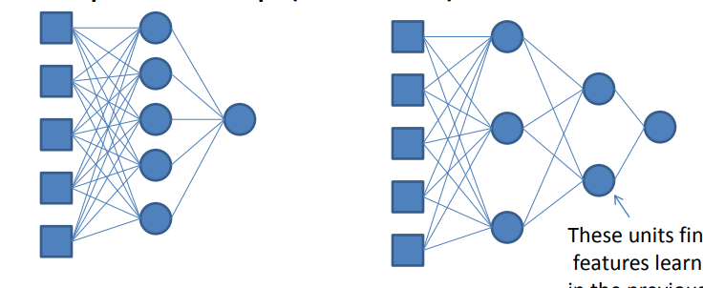
Multilayered CNN
Deep nets fine-tune the features learned by the previous layers.
30 parameters
23 parameters

Slide 34
Deep CNN: Example
GoogLeNet
Filter concatenation
3x3 convolutions
5x5 convolutions
1x1 convolutions
1x1 convolutions
1x1 convolutions
1x1 convolutions
3x3 max pooling
Previous layer
ILSVRC 2014 Winner

Slide 35
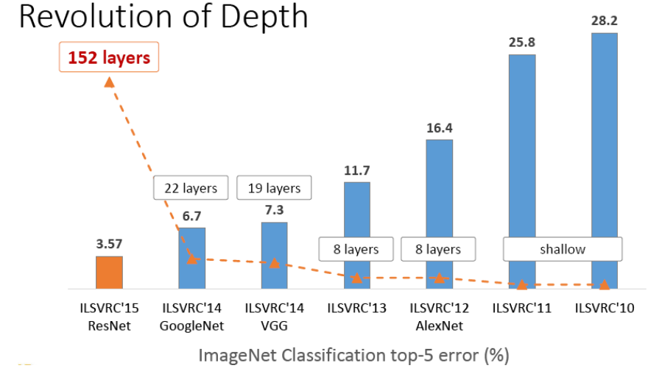
Deeper Is Better

Slide 36
Now, you are able to:
Implement CNN architecture
Implement Deep CNN
Optimize CNNs using pooling layers

Slide 38
The input image has been converted into a matrix of size 30 X 30 and a kernel/filter of size 7 X 7 with a stride of 1. What will be the size of the convoluted matrix?
1
24 x 24
21 x 21
28 x 28
7 x 7

Slide 39
The input image has been converted into a matrix of size 30 X 30 and a kernel/filter of size 7 X 7 with a stride of 1. What will be the size of the convoluted matrix?
1
24 x 24
21 x 21
28 x 28
7 x 7
a
The size of the convoluted matrix is given by C=((I-F+2P)/S)+1, where C is the size of the Convoluted matrix, I is the size of the input image, F the size of the filter and P the padding applied to the input matrix. Here P=0, I=30, F=7 and S=1.

Slide 40
Which of the following do you typically see in a ConvNet?
2
Multiple pool layers followed by a CONV layer
Multiple CONV layers followed by a pool layer
FC layers in the first few layers
All the above

Slide 41
Which of the following do you typically see in a ConvNet?
2
Multiple pool layers followed by a CONV layer
Multiple CONV layers followed by a pool layer
FC layers in the first few layers
All the above
b
A typical/deep ConvNet usually comprises of multiple convolutional layers followed by a pool layer.

Slide 42
Image Classification
Problem Statement: Asirra (Animal Species Image Recognition for Restricting Access) is a HIP (Human Interactive Proof) that works by asking users to identify photographs of cats and dogs. This task is difficult for computers, but studies have shown that people can accomplish it quickly and accurately.
Hint: Use the dataset folder provided with csv files for importing training and testing sets. Also, use cat.jpg to validate your model.
Objective: To write an algorithm to classify whether images contain either a dog or a cat. (Use Keras for this task).
Access: Click the Practice Labs tab on the left panel. Now, click on the START LAB button and wait while the lab prepares itself. Then, click on the LAUNCH LAB button. A full-fledged jupyter lab opens, which you can use for your hands-on practice and projects.

Slide 43
Thank You

